Slide 1
Team
Presentation
Baik ho jun(201020985)
Park Seong hyeon(201021626)
Jin won jun(201122817)
Son jae man(201420929)
Rho geun tack(201520860)
Notes:
Hello, My name is Hojun. I am going to talk about our project plans today.

Slide 2
CONTENTS
01
02
03
04
05
Application
Features &
Use case
Scenario
Sketches of
The user Interface
Class
Diagram
Team
Member
Roles
Schedule
Notes:
First, I am going to talk briefly about the application and use case scenario. And then I will talk more about the use case scenario using sketches of the user interface. And then I continue with a class diagram and team member role and project schedule.

Slide 3
01 Application Features
Educating application
for elementary school students
To create their own
Math-solving Program
Notes:
Let me introduce our project. Our aim of the project is to create an educating program that teaches elementary school students to create their own math-solving program that can be used in their math classes. We are going to create a training application which teaches the users how to make a program step by step. Our application will contain step by step explanation and quizzes at the end to check.

Slide 4
01 Use case scenario
Level: Easy, Normal, Hard
Concept (Study)
Quiz (Check)
Repeat
Notes:
First, select the difficulty of the level depending on the users’ computer programming ability.
There are three levels, Easy, Normal, and Hard.
After selecting the level, the user can select concept or quiz. When the user wants to learn about the programming, he can press concept and our application will guide the user from the basics. Once the user gets familiar with the programming, he can press Next button and take the quiz provided to check if he got the concepts right.
User can put his user id before taking quizzes so that the results will be saved and compared every time at the end of the quiz.
The user can use the results of the quizzes to select the difficulty of the level again from the beginning and continue until he completes the hard level.

Slide 5
02 Sketches of The user interface
Difficulty
chapter
variable
method
easy
normal
hard
Notes:
This is the interface of the pages of the application. The user can select the difficulty on the first page and press concept which takes to variable and method page.

Slide 6
02 Sketches of The user interface
Concept
Method is ~~~~
chapter
variable
method
input
method
output
Notes:
When the user selects method, the basic concepts of the chapter will appear.
For example, on this page, this shows how the user can use input and method to get output.

Slide 7
02 Sketches of The user interface
Concept
Method is ~~~~
Application
input
method
output
Enter input variable
Choose method
triangle
circle
square
Notes:
After the user is done with concept, he can press the next button. The next page will give application of the concept that was introduced in previous page. This will help the user to fully understand the concept.

Slide 8
02 Sketches of The user interface
Application
Enter input variable
Choose method
triangle
circle
square
Notes:
The application of the concept will be like this. If the concept was about input, method, and output, this page will show out input, method, and output works together. For examples if the triangle method is input, the output is the picture of the triangle.

Slide 9
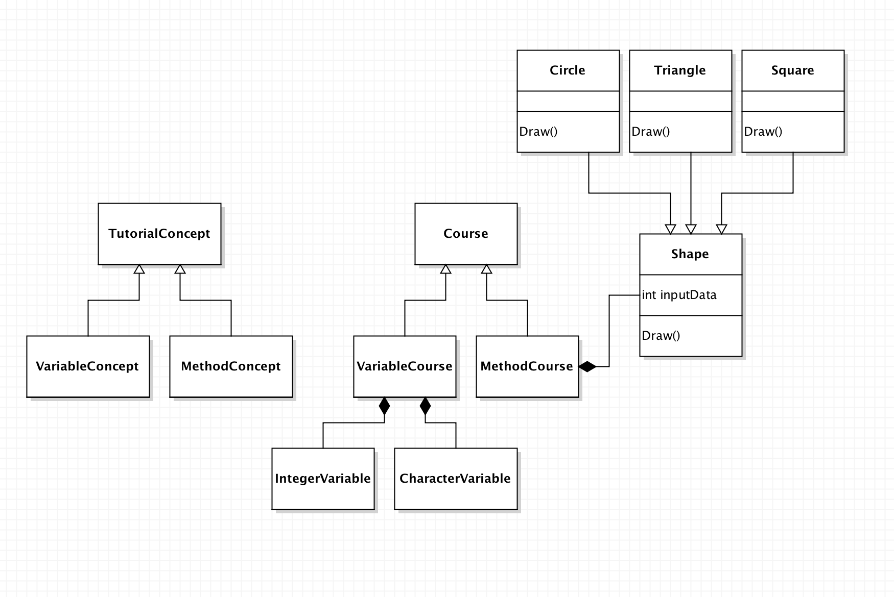
03 Class diagram
Notes:
‘Abstract class’ is used to create tutorial concept class and course class, because by using abstract class it will be easier to expand program with more information and repair later .
Circle, Triangle and Square class has the ‘Shape Class’ Method and they can be override.

Slide 10
- Baik ho jun ( Presentation & GUI & Overall Management) - Park seong hyeon ( MethodCourse Module & GUI ) - Jin won jun( MethodCourse Module & GUI ) - Son jae man(TutorialConcept Module & VariableCourse) - Rho geun tack(TutorialConcept Module & VariableCourse)
04&05 Team member roles & schedule
Activity | April | May | June
 | 1w 2w 3w 4w | 1w 2w 3w 4w | 1w 2w 3w 4w
Theme select
Project Planning
Specification
1st Implementation (Just before the GUI)
Mid-Review
2nd Implementation (GUI Implementation)
Final Wrap-up& Presentation
Notes:
This is the overview of our team and schedule.
The overall schedule is divided in to three. First implementation, Review, and second implementation.
We are planning on completing all the programming except GUI before first implementation and after the review we will concentrate on GUI for the second implementation.

Slide 11
Thank you!!
Notes:
Thank you for listing!!

